Slide 1
Drawings from Photos
Bahubali_VFX
Team members: Pavan, Shubham, Chirag, Sumanth
Mentor: BVK sir.
Repo URL: https://github.com/Digital-Image-Processing-IIITH/dip-m22-project-bahubali_vfx.git

Slide 2
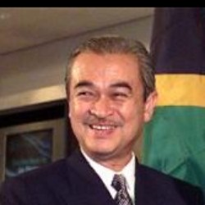
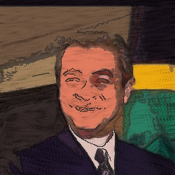
Problem Statement:
To produce NPR drawings from real-world photographs.

Slide 3
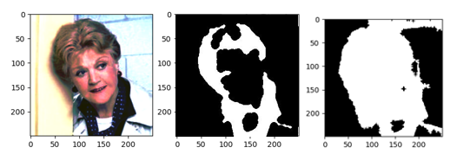
Saliency mask.
Limitation of paper:
1. Poor facial saliency map.
2. Better result with contrast-streching, but unique parameters for each image.
Original image
Without Contrast Stretching
With Contrast Stretching

Slide 4
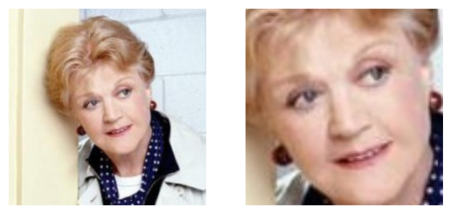
Face extraction
Solution:
Haar-Cascades for face extraction. Isolate the facial part of image. And execute further pipeline.

Slide 5
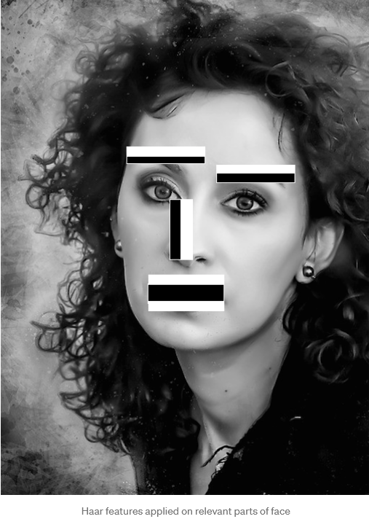
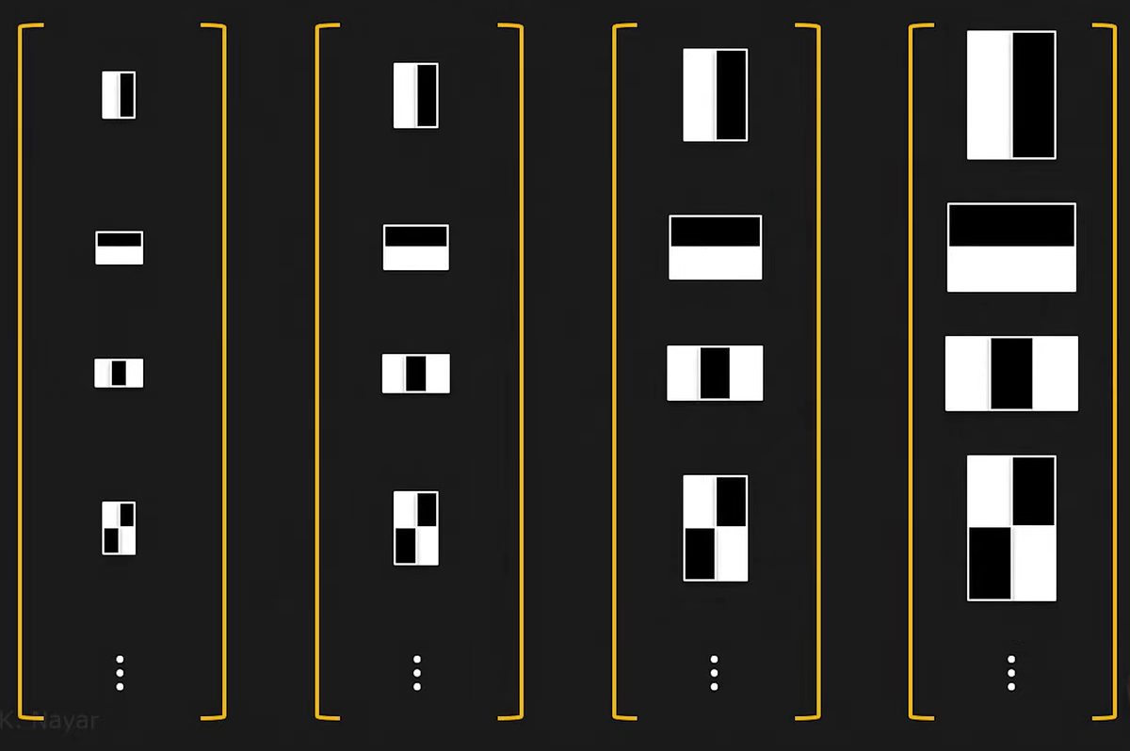
Face extraction
Haar Cascading:
Old school Viola Jones.

Slide 6
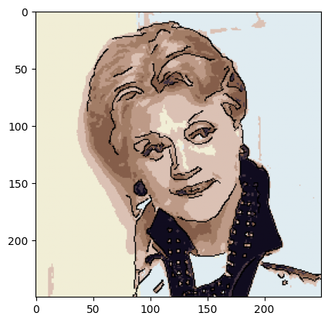
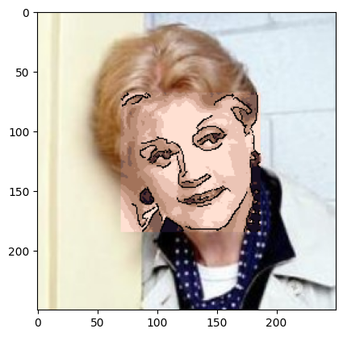
baseline
Baseline 1.
• Line-sketch generation: Canny edge detector.
• Color generation: LAB-space k-means clustering.
Baseline 2.
• Face extraction.
• Line-sketch generation: Canny edge detector
• Color generation: LAB-space k-means clustering.

Slide 7
Limitations of face extraction.
Problems:
1. Sharp change in rectangular facial area and background.
2. Intensity knowledge not used.
Future Scope:
1. All human body parts recognized.
2. Apply pipeline on body parts.

Slide 8

Line Integral Convolution-Techniques required
To obtain a line sketch image, two variants are proposed.
Canny edge detection
Line Integral Convolution
LIC provides more customizability than Canny edge detection, as parameters that are to be tuned are many.
Using line integral convolution, pencil-like sketch image is obtained as final output.

Slide 9

Line Integral Convolution-Techniques required
There are four stages involved in this process.
1. Obtain region labels
2. Noise image generation
3. Vector field image
4. Convolution of noise image to obtain final output.

Slide 10

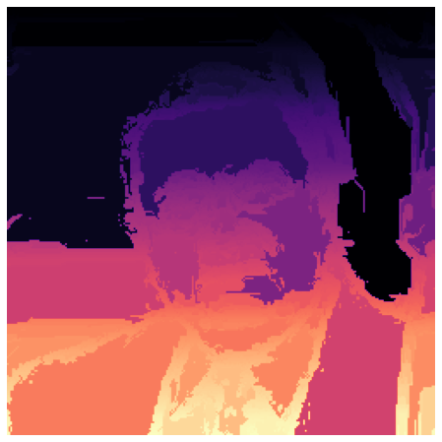
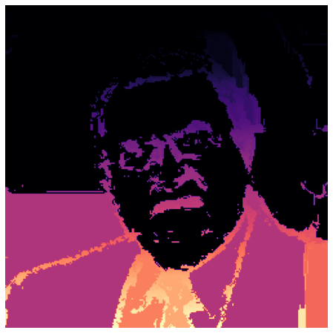
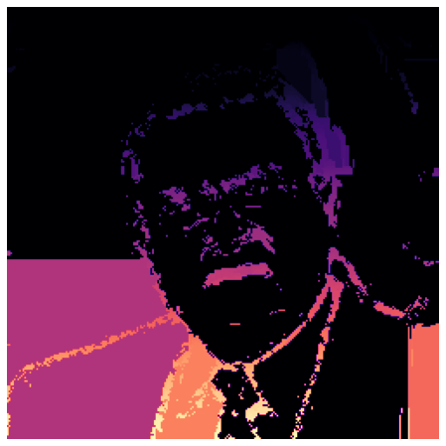
REGION LABELLING:
1. Similarity of each pixel with all immediate neighbors are computed.
2. Based on the similarity measure, pixels are merged and parent pixels are stored. Union find data structure is employed.
3. Labelling of image is solely based on similarity, where there is no guarantee always a face labelled image is extracted.
4. Failure to obtain required label is when background is not uniform. (Images are obtained by varying number of pixel merges)

Slide 11
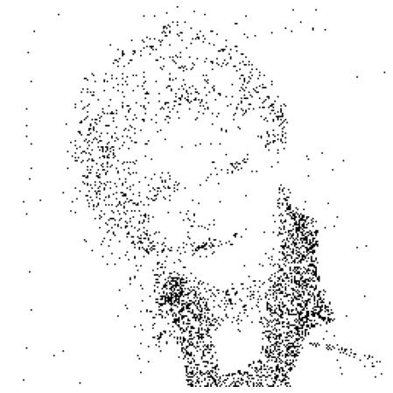
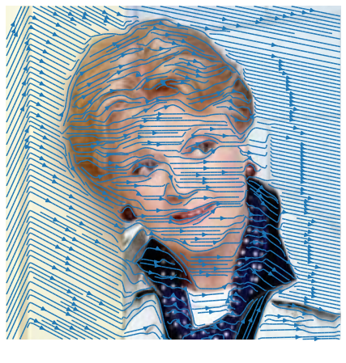
NOISE IMAGE GENERATION:
A noise image is generated, consisting of dots which are used as pencil strokes. The noise image is constructed where two thresholds and random image is used.
Average grey intensity value for each label is used for the selection of dots in the final image.
VECTOR FIELD IMAGE:
Vector field lines are generated from labelled image and label frequency, vector field lines are generated which helps in the formation of pencil sketch image as vector field lines are helps the pencil strokes to determine the direction.

Slide 12
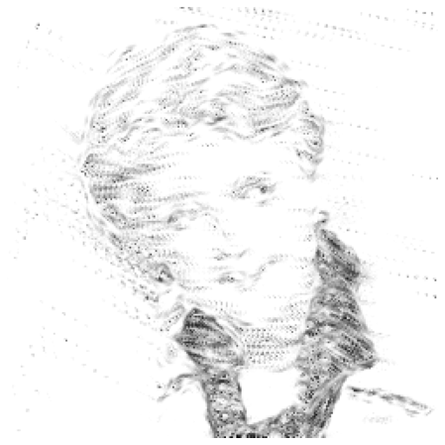
LIC OUTPUT IMAGE:
LIC moves a particle backwards and forwards in the vector field starting from each pixel position, samples the noise image over that streamline, and convolves those samples with a kernel.

Slide 13
Region of interest identification-Techniques required
1. Contrast stretching.
Histogram Equalization on individual channels produces better results.
The limitation of the paper we are referring to is that they are unable to obtain good saliency map.
Solution: Increase dynamic range (contrast) of the image to have better distinction between FG and BG

Slide 14
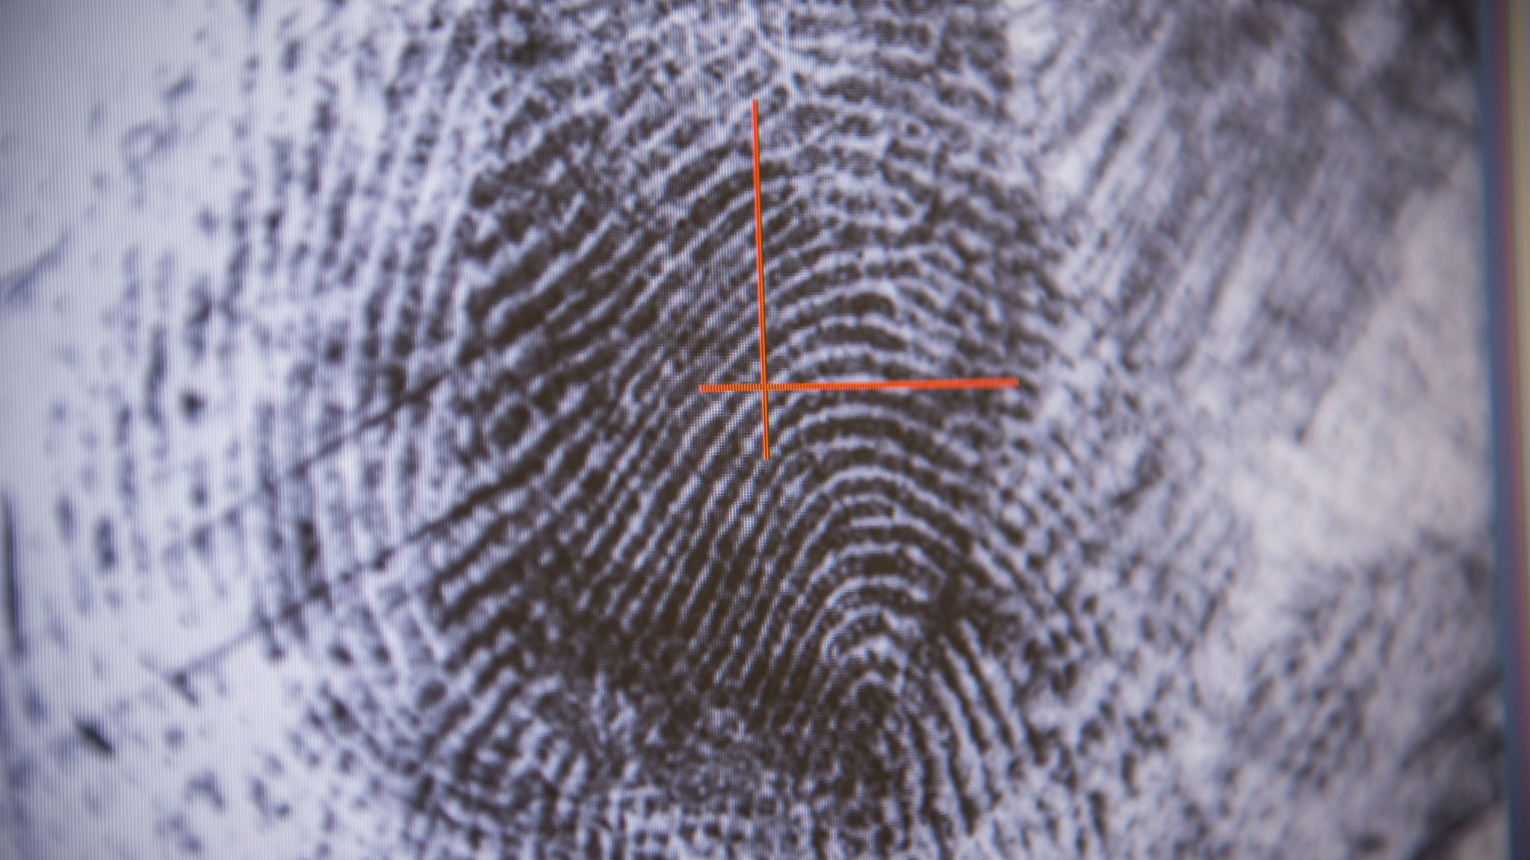

Region of interest identification-Techniques required
2. Saliency Map.
$S(C)=\sum_{Ck}{nk|\left|C−Ck\right||}$
RGB Quantization
The image is quantized using simple quantization method by dividing the 0-255 range into 12 parts. Increasing the number of quantization level is computationally expensive. And decreasingit below 12 gives degraded output.
Colour Histogram (C)
To obtain histogram (intensities and frequencies) of the quantized RGB image.
Compute Saliency
Replacing each color pixel with its associated saliency produced a grayscale image called a saliency map.
Otsu’s method was used to binarize the map into foreground and background.

Slide 15
Color generation
To obtain colors from the original image for the sketch we again have two implementations discussed as follows:
1. LAB Space K-means Clustering
2. Generation from Region Segmentation

Slide 16
Generation from region segmentation
The goal is to ensure that different regions of the images are assigned different colors, to preserve the structure content of the input.
The idea is to use a region segmentation algorithm to identify what are the different regions of the image.
Then for each region, assign the mean color value to every belonging pixels. The averaging was done in the LAB-space that better accounts for human color perception.
First, opening-closing by reconstruction is performed on the grayscale version of the input image to sharpen the transitions between regions. Then a Sobel gradient-based edge detector is applied to detect the region edges.
Finally, region labelling is run on the complement binary image to identify the distinct regions.

Slide 17
Generation from region segmentation
Mean color of different regions is calculated and then a gamma correction technique is used to further boost the color differences.
Then all pixels belonging to a particular label is assigned the corresponding color.

Slide 18
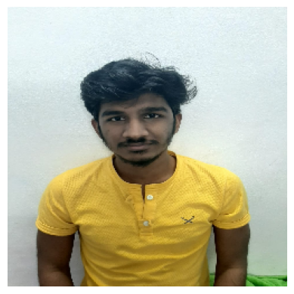

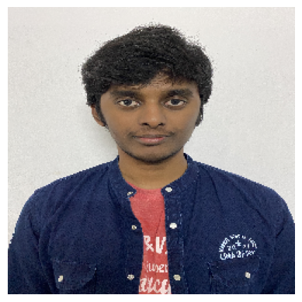



Real Life Data - Inputs

Slide 19
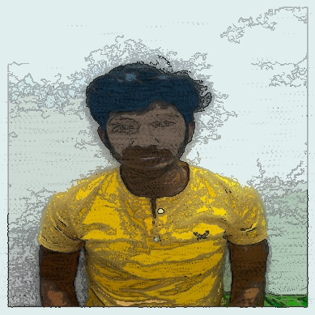
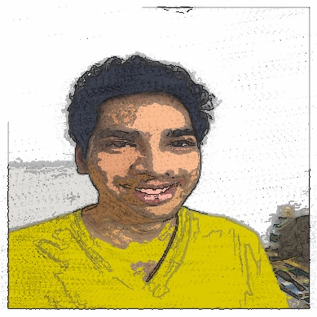
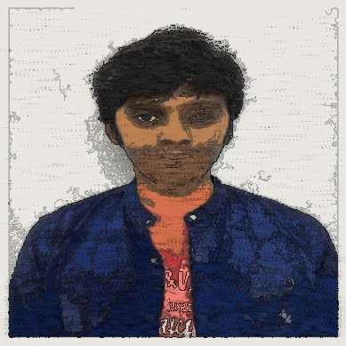
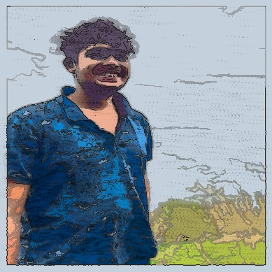
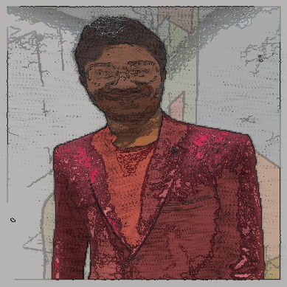
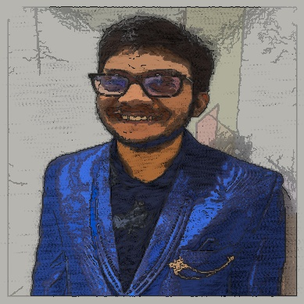
Real life data – outputs(Lic)

Slide 20
division of work
Everyone contributed almost equally.
Saliency Mask: Chirag.
Line Integral Convolution: Pavan and Sumanth.
Color Generation from Region Segmentation: Shubham.

